Slide 1

Categorical scores
YES/NO
Marion Mittermaier
MPEDTP Virtual Summer School
22 June 2021

Slide 2
Topics covered
The Murphy and Winkler (1987) framework, expanding on concepts such as joint/marginal distributions.
Contingency table
selecting metrics that use all elements of the CT; focus on independent and complementary scores
Different kinds of thresholds (strengths and weaknesses); false skill
Strengths and weaknesses of categorical metrics
Double penalty and km-scale modelling
Multi-categorical contingency tables, Gerrity score.
Newer scores such as SEEPS that incorporate climatology
Skill scores: types of reference forecasts (strengths and weaknesses)
Different observations of the same thing producing conflicting results

Slide 3
Basic concepts
Categorical: only one of a set of possible events will occur
Categorical forecast does not contain expression of uncertainty
There is typically a one-to-one correspondence between the forecast values and the observed values.
The simplest possible situation is a 2x2 case or verification of a categorical yes/no forecast: 2 possible forecasts (yes/no) and 2 possible outcomes (event observed/event not observed)

Slide 4
Binary (dichotomous) events Yes/No, presence/absence
Examples
Underlying continuous variable
It’s foggy
There’s a frost
It’s raining
There’s a thunderstorm (in a given area)
Visibility
Air / ground temperature
Rainfall accumulation
Lightning flash rate
Notes:
Most if not all dichotomous variables arise from putting a threshold on a continuous variable.
In the case of rainfall and lightning, this is often zero / non-zero
– these have mixed distributions with a large spike at zero.
(Even in south-west England it doesn’t rain most days, let alone most hours!)
By contrast, visibility and temperature don’t have such natural thresholds.

Slide 5
Dichotomization
Advantages
Disadvantages
Easier to explain and present
User-meaningful thresholds
e.g. aviation, wind power
Lose information
Threshold(s) must be chosen
Can be hard, may be arbitrary
Simpler to analyze?
I’m afraid not!
Notes:
User-meaningful thresholds:
– aviation: thresholds for greater spacing of landings and take-offs and to close runway completely.
– wind turbines: cut-in speed, cut-out speed and survival speed.
Lose info – as demonstrated in last lecture, results in less statistical power, so harder to demonstrate a statistically significant difference.
Forecast verification started with binary events, and you might think they would be simpler to analyse than continuous ones, but, I’m afraid that’s not the case, as I’m going to show you. In fact, verification of probabilities of binary events has several advantages. See Jonathan’s lecture at 2pm on 19 May.

Slide 6
The Murphy & Winkler framework 1
Based on the joint distribution of forecasts and observations.
Designed to work for a simple yes/no (e.g. rain, no rain), multiple categories (e.g. clear, partly cloudy, overcast) and even something probabilistic (e.g. 60% chance of rain tomorrow).
Let p(f,x) denote the joint probability of the forecasts f and the observations x, which contains information about the forecast, the observations and the relationship between the two.
(Note: a yes/no categorical forecast is a special case of a probability forecast where a probability of 1 is assigned to a particular event.)

Slide 7
The Murphy & Winkler framework 2
Because we want the best forecasts possible we would like a high proportion of forecasts to be close to the observations and a low proportion to be far away.
To learn more about the forecasts the joint distribution can be factorised into a combination of marginal and conditional distributions to give two perspectives.
Calibration-refinement: p(f, x) = p( f | x ) p(f) (how often different observations have been made for a given forecast)
Likelihood-base rate: p(f, x) = p( x | f ) p(x) (how often are different forecasts made before it is observed and p(x) is the base rate (frequency of observed occurrence)
The two factorisations are related through Bayes’ theorem:
p(x | f ) = p(x) p(f | x) / p(f)

Slide 8
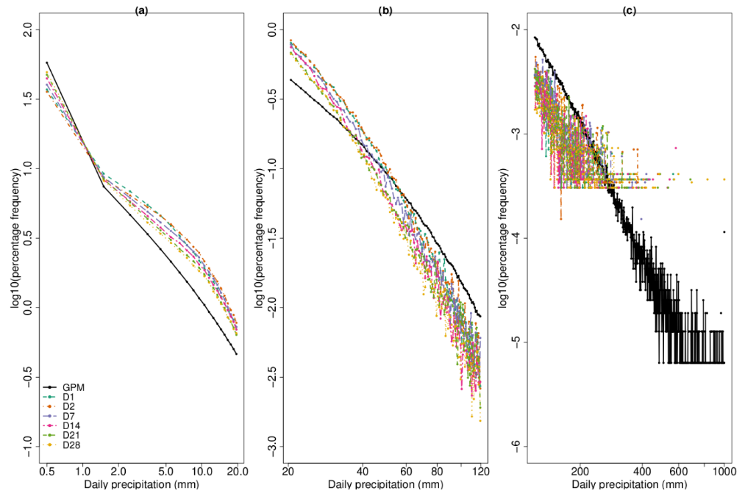
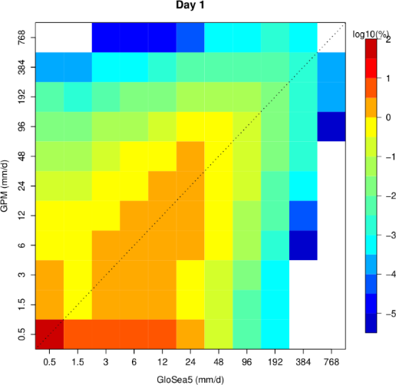
Example of marginal and joint distributions
Model distributions change with lead time
Joint (binned, multi-category) distribution of daily rainfall between GPM and D1 forecasts (if there was perfect correspondence all the values would be in the bins along the diagonal
Marginal distributions of daily rainfall for different lead times
Output from MET tool GridDiag

Slide 9
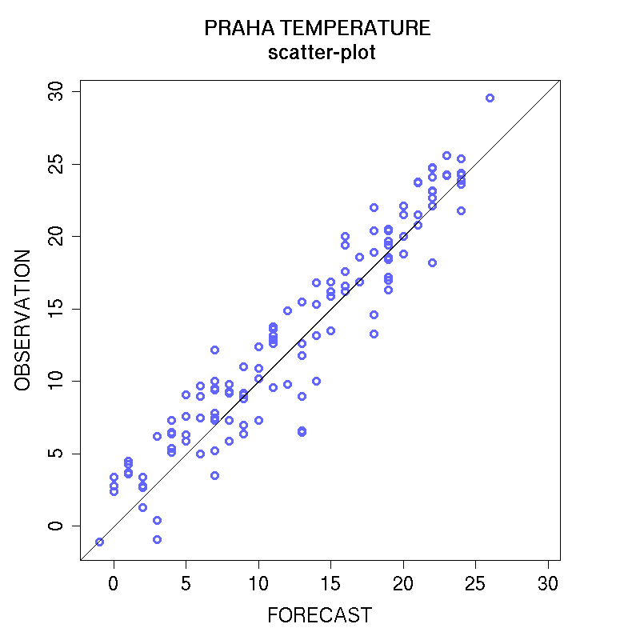
The scatter plot and joint distributions
Plot of matched (observation, forecast) pairs
Perfect when data points fall on 1:1 line
Incredibly useful for examining the nature of your dataset:
Is there a bias?
Are there outliers?
Is there a linear association? How strong? Does it change with magnitude?
What happens in the tails?

Slide 10
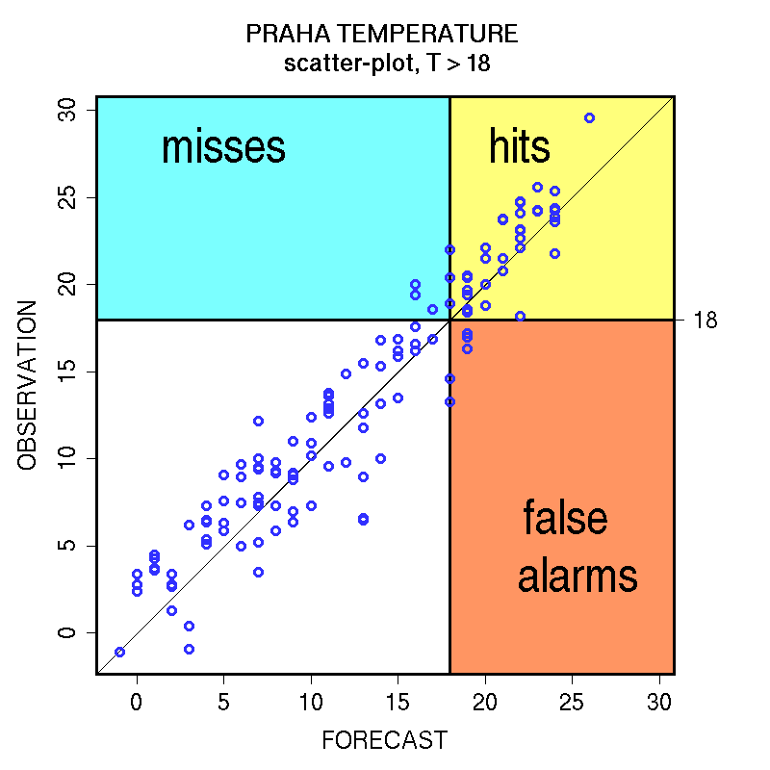
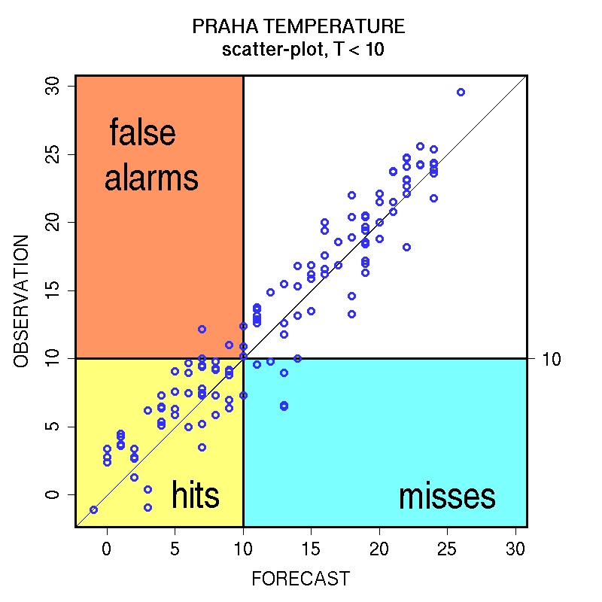
The link between a scatter plot and a contingency table
Does the forecast detect correctly temperatures above 18 degrees ?
Does the forecast detect correctly temperatures below 10 degrees ?

Slide 11
Contingency tables
Marginal probability: sum of column or row divided by the total sample size
For example: the marginal probability of a yes forecast is:
p_{x}=Pr(X=1) = 100/2800 = 0.03
Tornado forecast | Tornado Observed
 | yes | no | Total fc
yes | 30 | 70 | 100
no | 20 | 2680 | 2700
Total obs | 50 | 2750 | 2800
Sum of rows
Total sample
size

Slide 12
Contingency tables
Joint probability: represents the intersection of two events in a cross-tabulation table.
For example: the joint probability of a yes forecast and a yes observed:
P_{x,y}=Pr(X=1,Y=1) = 30/2800 = 0.01
Tornado forecast | Tornado Observed
 | yes | no | Total fc
yes | 30 | 70 | 100
no | 20 | 2680 | 2700
Total obs | 50 | 2750 | 2800

Slide 13
Standard notation
Event forecast? | Event observed?
 | Yes | No | Total:
Yes | hits | false alarms | events forecast
No | misses | correct rejections | non-events forecast
Total: | events observed | non-events observed | all events (sample size)
Computed as follows from a dataset F and O and an event threshold th:
Hits = a = (F >= th) & (O >= th)
False alarms = b = (F>= th) & (O < th)
Misses = c = (F < th) & (O >= th)
Correct rejs = d = (F < th) & (O < th)
Event forecast? | Event observed?
 | Yes | No | Total
Yes | a | b | a + b
No | c | d | c + d
Total | a + c | b + d | n = a + b + c + d
Q: Why might the categorical evaluation of warnings be problematic?
Need three measures to completely describe the joint probability distribution (n is the denominator)
Notes:
Need three measures to completely describe the joint probability distribution (n is the denominator)

Slide 14
Need 3 quantities to fully describe joint distribution
There are a plethora of contingency-table based scores to compute. The easiest non-textbook reference is https://community.wmo.int/jwgfvr-verification.
However, most of them are NOT independent. To fully describe the joint distribution there are only two options for obtaining independent information. Any categorical analysis should always include these:
1. Base rate s, hit rate H and false alarm rate F
or :
2. Base rate s, frequency bias B and an overall accuracy measure
The base rate s is a property of climatology so cannot be altered by the forecast system → base rate s (and sample size n) characterise the observations
Another two measures are needed to characterise the forecast system
Notes:
Base rate is a property of the climatology of the observations, not of the forecasting system. So although it’s of interest to see how forecast performance varies with base rate, it doesn’t tell us anything about the quality of our forecasts.
If forecasts were unbiased, we’d also remove one degree of freedom.
But they often aren’t unbiased -- can exhibit substantial bias, especially at more extreme thresholds.

Slide 15
Independent measures
Probability of detection (hit rate) POD = hits ∕ events observed = a ∕ (a + c)
Probability of false detection (false alarm rate) POFD = false alarms ∕ non-events observed = b ∕ (b + d)
Not to be confused with
False alarm ratio FAR = false alarms / events forecast = b ∕ (a + b)
Base rate
s = events observed ∕ all events = (a + c) ∕ n
Frequency bias
B = events forecast ∕ events observed = (a + b) ∕ (a + c)
Range [0, 1]
Range [0, 1]
Range [0, 1]
Not independent!
Notes:
Base rate is a property of the climatology of the observations, not of the forecasting system. So although it’s of interest to see how forecast performance varies with base rate, it doesn’t tell us anything about the quality of our forecasts.
If forecasts were unbiased, we’d also remove one degree of freedom.
But they often aren’t unbiased -- can exhibit substantial bias, especially at more extreme thresholds.

Slide 16
Peirce skill score (C.S. Peirce, 1884)
Using a performance metric that is built on H and F can be useful.
Here, we give TWO examples….
Known by many names: (true skill statistic, Hanssen & Kuiper’s discriminant, Kuiper’s performance index, Youden’s index, risk difference …)
PSS = H − F = (ad − bc) (b + d)(a + c)
Has a simple definition (based on H and F) and good properties.
Penalizes misses and false alarms equally
Can be extended to multiple categories.
Range [−1, 1]
Notes:
PSS has been rediscovered many times! This itself tells us something.
Generally good properties it’s easy to understand the definition, it’s independent of the base rate, it’s difficult to hedge..
(In fact, the ETS, HSS and others also have numerator (ad – bc) but different denominators.)
But it does assume misses and false alarms are equally bad – a more user-orientated approach would take account of the user’s opinion, or cost-loss ratio. But note that this would favour biased forecasts!

Slide 17
Rare events
Note: It took various authors 3 attempts at getting this right! Earlier versions (EDS, SEDS) have been largely superseded/improved upon – no reason to use them.
(S)EDI have bettern properties and though EDI has a simpler definition and is easier to understand, there is no reason not to use SEDI in practice (v. similar value for rare events, sensible also when event definition switched i.e. for v common events).
As the base rate s tends to zero, most performance measures (PC, PSS, TS, ETS, HSS) tend to a meaningless fixed value (1 for PC, 0 for others). – They are degenerate for rare events
A measure that avoids this is the (symmetric) extremal dependence index
(S)EDI = ln(F) − ln(H) [+ ln(1 − H) – ln(1 − F)] ln(F) + ln(H) [+ ln(1 − H) + ln(1 − F)]
(S)EDI is independent of the base rate s
Not all rare events are extreme though most extreme events are relatively rare

Slide 18
Interpretation: is the value of my score good or bad?
Given a score of x, is that good or not? For the basics (base rate and bias) it relatively easy. But is an POD of 0.2 good? What about a SEDI of 0.7?
The “goodness” (for a user) can be difficult to establish, dependent on the user and potentially highly subjective.
If calculated values are near the bounds it can be considered “easier” but any values near the bounds should also make you ask yourself some (other) scientific questions (i.e. relating the metric back to the meteorology). Here a broader understanding of your forecasts and your observations is essential. This can often be improved by considering the datasets spatially and/or temporally, i.e. not just in some aggregated sense.
Looking at a range of scores can help, provided you understand each of the metrics, what they measure and their strengths and weaknesses. Otherwise it can confuse….
Skill scores are generally easier to interpret because they are relative to the accuracy of another forecast.

Slide 19
Verification history: Finley’s tornadoes
Tornado forecast | Tornado Observed
 | yes | no | Total fc
yes | 30 | 70 | 100
no | 20 | 2680 | 2700
Total obs | 50 | 2750 | 2800
PC=(30+2680)/2800= 96.8%
POD = 30/50 = 60%
POFD = 70/100 = 70%
B = 100/50 = 2
Tornado forecast | Tornado Observed
 | yes | no | Total fc
yes | 0 | 0 | 0
no | 50 | 2750 | 2800
Total obs | 50 | 2750 | 2800
PC=(2750+0)/2800= 98.2%
POD = 0 = 0%
POFD = 0 = 0%
B = 0/50 = 0
So, if you forecast nothing you do better?

Slide 20
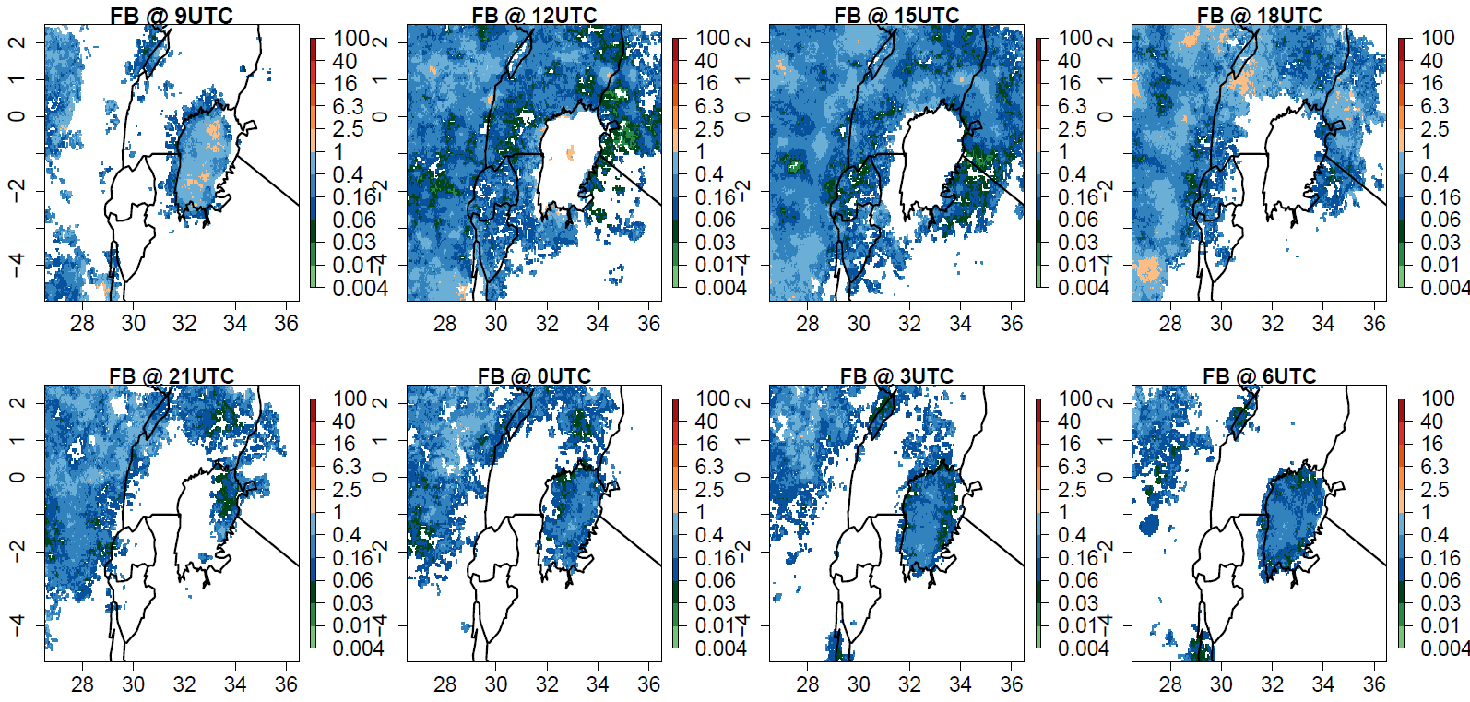
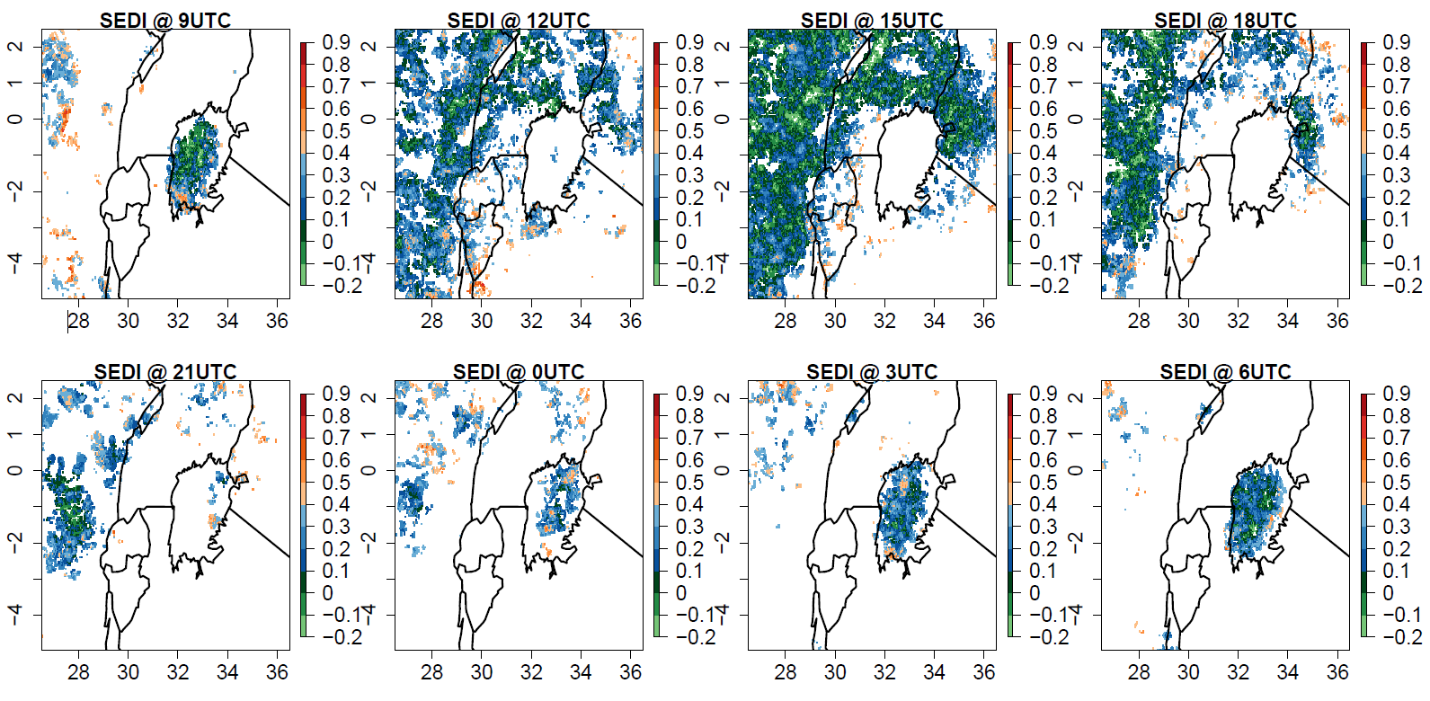
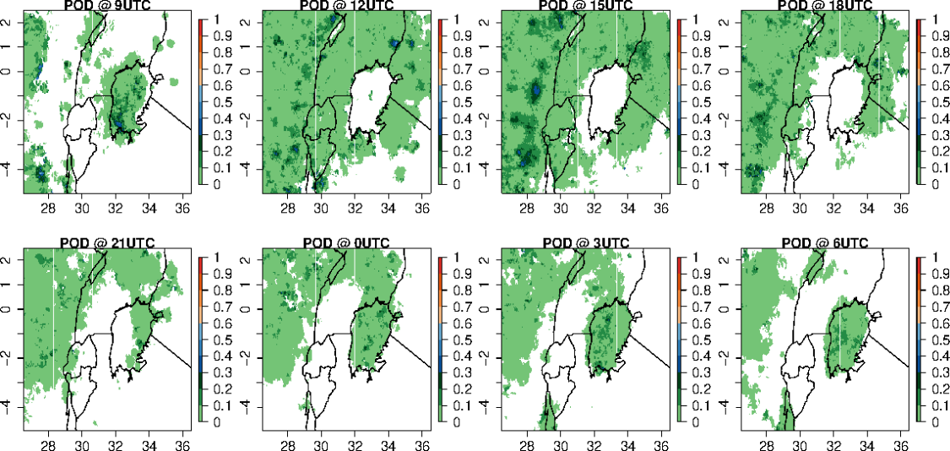
Practical question:
Scores for the occurrence of any lighting from a 4.4 km model and gridded lightning data over Lake Victoria region for period ~192 day period broken down in space and time.
1. What sampling effects may come into play when computing scores on a grid? (i.e. a time aggregate at a point)
2. Comparing the SEDI and the POD, would you say the forecast is skilful?
3. If you aggregated the domain and produced a line graph, could this change your interpretation?

Slide 21
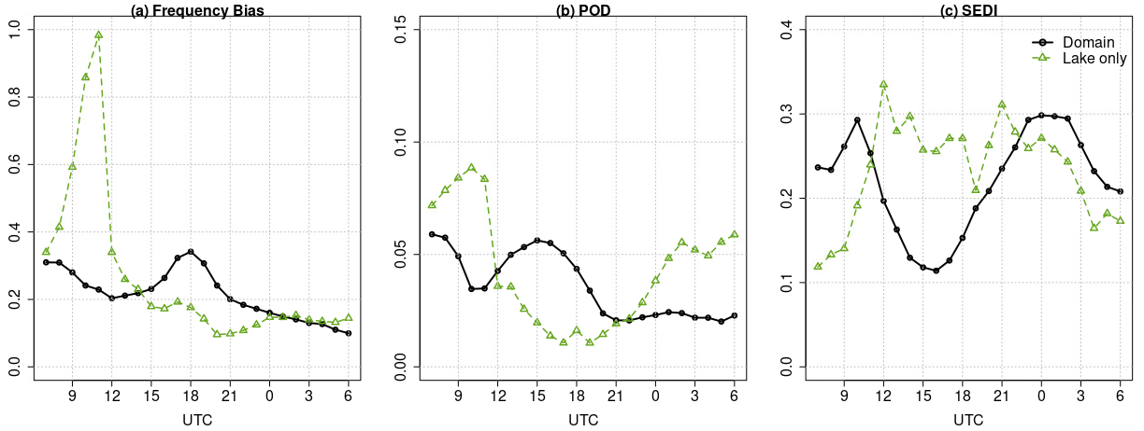
Practical question part 2:
Scores for the occurrence of any lighting from a 4.4 km model and gridded lightning data over Lake Victoria region for period ~192 day period broken down in space and time.
3. If you aggregated the domain and produced a line graph, could this change your interpretation?
4. What does the partitioning do? Why could this be important more generally?
5. How should scores be aggregated? Why?

Slide 22
Measuring skill by constructing a skill score
SS = Score – Score_{ref}
Score_{perf} - Score_{ref}
Skill score: measure the forecast accuracy with respect to the accuracy of a reference forecast: positive values = skill; negative values = no skill
Difference between the score and a reference forecast score, normalized by the score obtained for a perfect forecast minus the reference forecast score
In theory there is no limit to which scores are used to construct a skill score so long as you know what the perfect score is and you can compute a score for your chosen reference forecast.

Slide 23
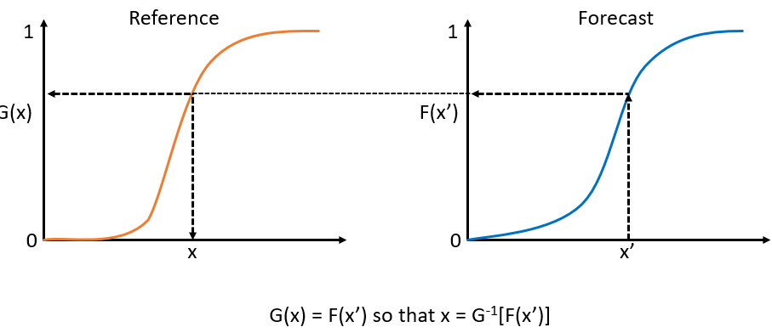
Choosing thresholds wisely
Thresholds can be highly arbitrary and/or driven by user requirements. If the latter, think about the implications very carefully.
Some rules to consider:
Choose thresholds that suit the data (what is the underlying distribution?)
Is there a bias? Choose metrics that are insensitive to the bias or choose to transform your data, e.g. via some form of quantile mapping. In this case the bias has to be monitored separately.
Use long-term climatological thresholds or climatologically relevant thresholds. This is particularly important when attempting to aggregate over regions so that the thresholds are relevant to each location.

Slide 24
Types of reference forecasts
To measure skill you need to compare to something, that can be considered a forecast for the observed event.
Type | Example | Properties
Random | Equitable Threat Score | Well understood statistical benchmark Not physically meaningful
Persistence | Constructed skill score | Measure of predictability (predictability is low when persistence is a poor forecast) Show value added by running NWP model
Sample climate | Constructed skill score | One step further removed than persistence, i.e. smoothed Retains predictability element due to regime dependence
Long-term climatology | Constructed skill score, extremes | Easiest reference to beat, smoothest Care required i.t.o. representativeness, pooling issues, climate change trends
a posteriori
a priori

Slide 25
Multi-category events
Equitability (or at least asymptotic equitability is important.
These can become extremely technical and there can be many pitfalls, i.e. proceed with caution.
Most commonly created from splitting continuous variable at multiple thresholds
6-hour precip: 0.5, 1, 4 millimetres
Total cloud amount: clear, partly cloudy, cloudy (defined by some bounds)
Visibility 200, 1000, 4000 metres
Most often analysed as a set of 2×2 tables by dichotomizing at each threshold in turn
– Giving three 2×2 tables in each of above case

Slide 26
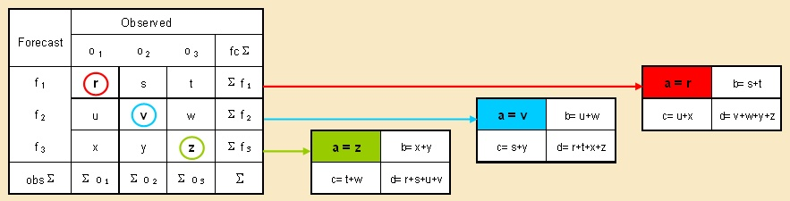
Multi-category events
Generalized version of HSS and PSS - measure of improvement over random forecast

Slide 27
Multi-category events: single overall scores
Hedging: best thought of as a sensitive to the bias,
e.g. the score can be improved through over forecasting,
i.e. not forecasting the true frequency
For ordered categories (as formed by splitting continuous variables), most common is the Gerrity score
LEPSCAT is an alternative
But less sensitive to skill trends and more vulnerable to hedging
SEEPS (Stable Equitable Error in Probability Space) often preferable for three ordered categories (but can be extended to more)
Sensitive to trends in forecast skill
Designed for precipitation but there is no reason why it can’t be used for other quantities provided a climatology can be computed.
Notes:
Ask Rachel North if you want to know more about SEEPS.

Slide 28
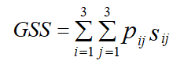
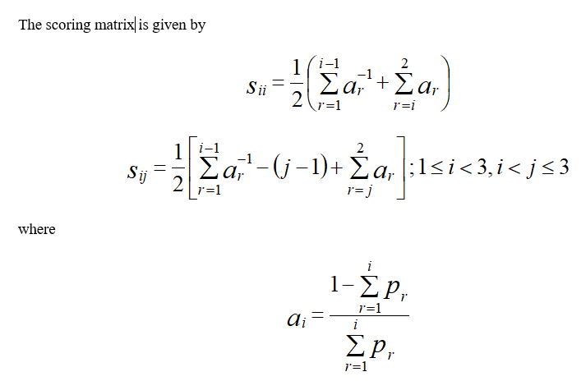
Gerrity score
Recommended score for 3 x 3 tables with many desirable properties.
Uses a scoring matrix which is a tabulation of the reward or penalty for every forecast/observation outcome represented by the contingency table.
Uses sample probabilities, not those on which the categories are based (i.e., not 1/3, 1/3, 1/3 for a 3 x 3 table)
Provides consistency in terms of any underlying correlations and from categorisation to categorisation.
The score is equitable, does not depend on the forecast distribution, does not reward conservatism, utilizes off diagonal information in the contingency table, and penalizes larger errors more.

Slide 29
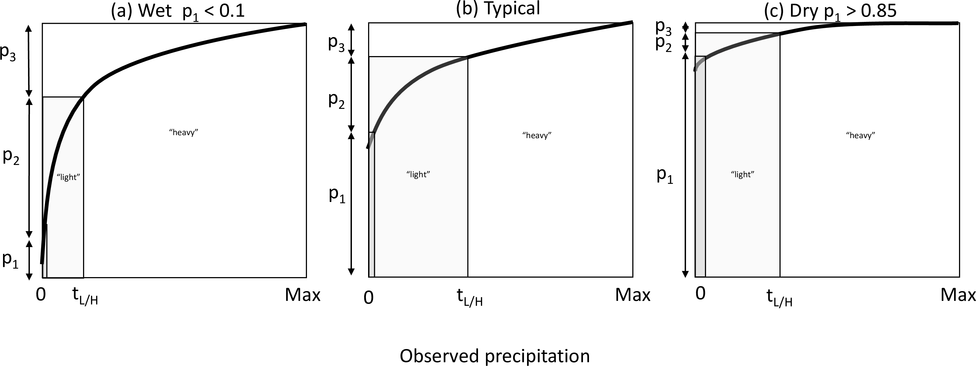
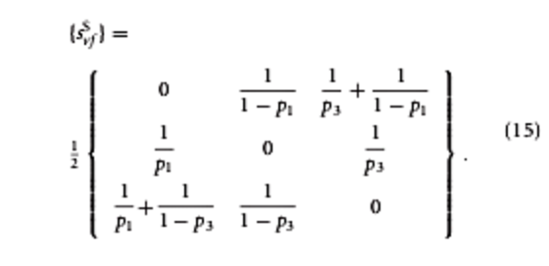
SEEPS: a multi-category score which utilises a climatology
See Rodwell et al. (2010), Haiden et al. (2012), North et al (2013), North et al (2021).
Multi-category score
Typically 3-categories; for precipitation use: dry, light and heavy
Can be written as the mean of two 2-category scores assessing the dry/light and light/heavy boundaries
Can be calculated at stations, or on a grid, provided there is a climatology available
Categories are combined using a weighting matrix.
Commonly formulated as an error score with 3 categories: dry, light, heavy with 1-p₁ split so that p₂ = 2 * p₃
Error matrix from Rodwell et. al.
(2010)

Slide 30
The concept behind SEEPS
Defining the boundaries between the categories is very flexible.
Designed to be insensitive to sampling uncertainties
Error score with a perfect score of 0 (usually 1-SEEPS is plotted)
Asymptotically equitable
Locations where the climatology is located in the upper or lower tails can be unstable and can make any aggregated score unstable and unreliable. It is best to remove these before doing any aggregation; e.g. for precip p₁ the dry/light probability threshold is set as follows:

Slide 31
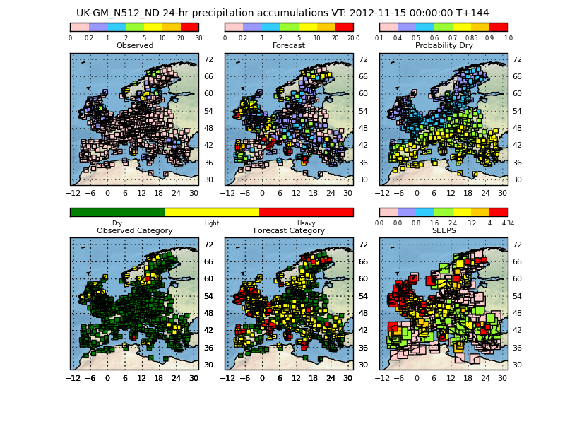
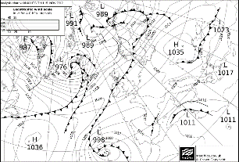
SEEPS as a diagnostic tool
The score and the components can be plotted to help diagnose systematic behaviour based on the climatological distributions.
This makes it a powerful tool in addition to providing an overall error.
Notes:
Ability to plot individual scores and their associated characteristics.
Here we plot the observed and forecast accumulations themselves, the probability of dry weather for each station from the climatology for the specific date and time of interest. Then on the second row, we have the observed and forecast categories, and the SEEPS scores at each station.
Large forecast totals in a band across Southern Scotland/Northern England, and Mediterranean. Not actually observed.
Large SEEPS across Scotland/Northern England.

Slide 32
Multi-category events: single overall scores
For unordered categories (e.g. precip type), Pierce skill score and Heidke skill score can be extended
Their properties are not ideal, however (Livezey)
Form depends on forecast distribution
Weight all correct forecasts the same, which encourages conservative forecasts (forecasting the most common event)
May be possible to tailor a score for a specific application, but considerable care needed

Slide 33
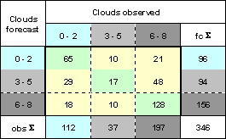
Multi-category events example
Compute the scores for the following 3 category cloud forecasts.
Calculate:
PC = ?
KSS = ?
HSS = ?

Slide 34
False skill? Why do we need to care?
Introduced in the process of aggregating in time or space (e.g. Hamill and Juras 2007)
Space: mixing locations which have a very different base rate.
Time: mixing seasons
This implies a threshold dependence: e.g.
Push the threshold too high: some regions will never contribute if values above that threshold are not climatologically possible/likely; only a few locations dominate the statistics and the overall score is not representative. (i.e. even if we are tempted to do this to measure “extremes”, real care is needed to only aggregate over locations which have similar climatologies)
Keep the threshold too low: all places can contribute but you may not be measuring what you want, and you may still be mixing locations with different base rates.

Slide 35
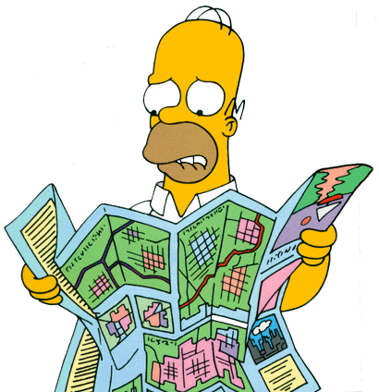
Exercise: Homer the aviation forecaster
Springfield airport often closed due to fog
Homer’s new job: Forecast whether it will be foggy enough the next day to shut the runway
Six months later...
Mayor Quimby asks: Are Homer’s forecasts any better than just tossing a coin? If they are, how much better? Is he improving?
© Twentieth Century Fox Film Corporation
Notes:
Springfield airport often closed due to fog
Homer’s new job: Forecast whether it will be foggy enough the next day to shut the runway
Six months later...
Mayor Quimby asks: Are Homer’s forecasts any better than just tossing a coin? If they are, how much better? Is he improving?

Slide 36

Homer’s performance December to May
Fog forecast? | Fog observed?
 | Yes | No | Total
Yes | 35 | 56 | 91
No | 21 | 70 | 91
Total | 56 | 126 | 182
Base rate s = (35 + 21) / 182 = 0.308
Bias B = (35+56) / (35 + 21) = 1.625
POD POD = 35 / 56 = 0.625
POFD POFD = 56 / 126 = 0.444
Peirce skill score PSS = 0.625 − 0.444 = 0.18
Q: does Homer have reason to celebrate?
Notes:
2-sided p-value 0.025

Slide 37
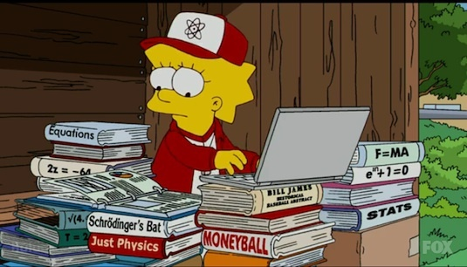
Lisa isn’t convinced and wants a closer look...
© Twentieth Century Fox Film Corporation

Slide 38
Homer’s performance
Lisa partitions the events by season….
Q: Recompute the scores. What do they tell you?
December to February
March to May
Fog forecast | Fog observed?
 | Yes | No | Total
Yes | 33 | 43 | 76
No | 7 | 7 | 14
Total | 40 | 50 | 90
Fog forecast | Fog observed?
 | Yes | No | Total
Yes | 2 | 13 | 15
No | 14 | 63 | 77
Total | 16 | 76 | 92

Slide 39
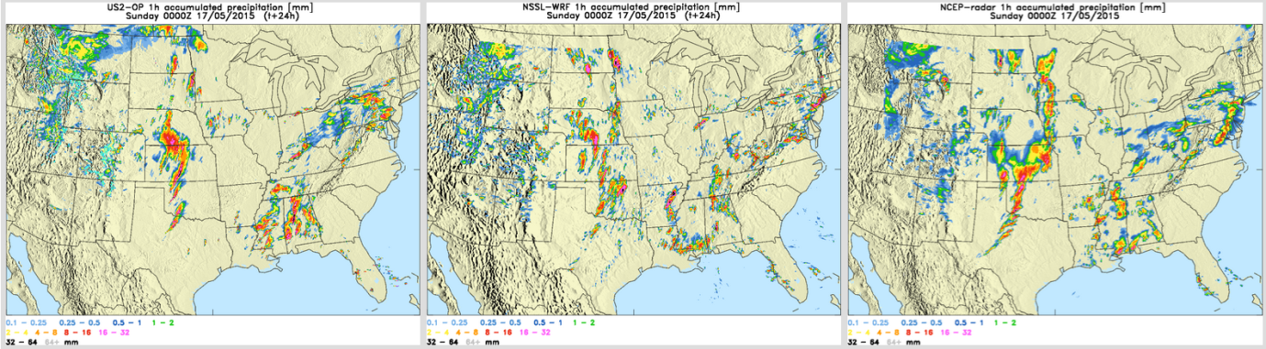
Double penalty and km-scale models
The detail looks very realistic but is it right?
Q: What happens if you calculated categorical scores based on a pointwise comparison between these models and the radar?
From Kain et al. 2016

Slide 40
We shouldn’t believe high-resolution at or near the grid scale: so, we shouldn’t attempt to verify it!
‘Unreliable’
Scale
Distribution of instability well predicted at larger scale
Individual cell
Locations ‘random’
Model numerics imply that features only 2-4 Δ can be resolved
Probability
Rainfall
Courtesy of Peter Clark
© Crown copyright Met Office

Slide 41
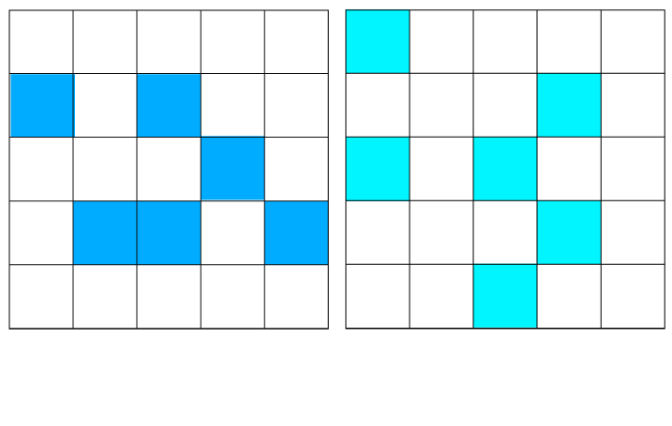
How the double penalty comes about…
observed
forecast
Consider this example where the number of threshold exceedances (6) are the same but none overlap.
Each of the exceedances has a “match” which is displaced.
In this case a pointwise comparison will count the error 12 times (twice the threshold exceedances) due to this displacement, i.e. the forecast is penalised for not having the event where it is observed, and for forecasting the event where it was not observed.
FA
M
M
FA
M
FA
FA
M
M
M
FA
FA
Threshold exceeded where squares are blue
More on how we mitigate against the double penalty in the spatial methods lecture

Slide 42
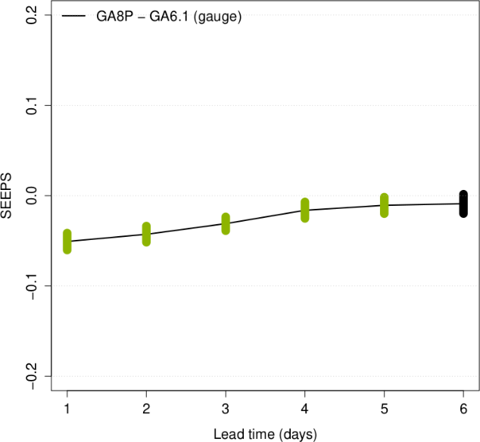
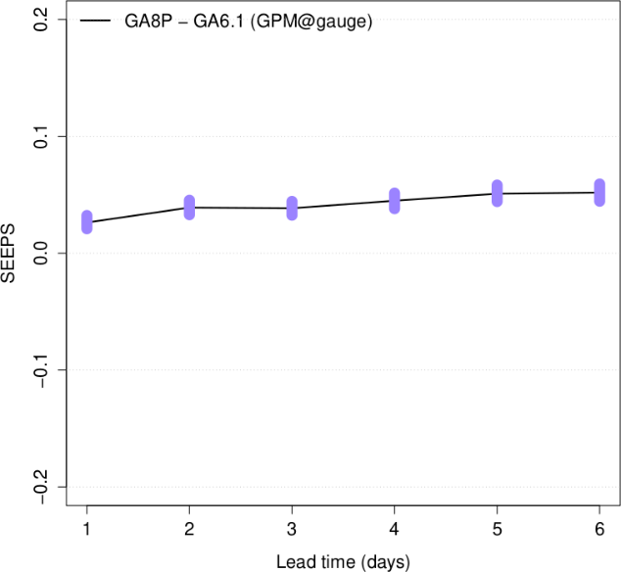
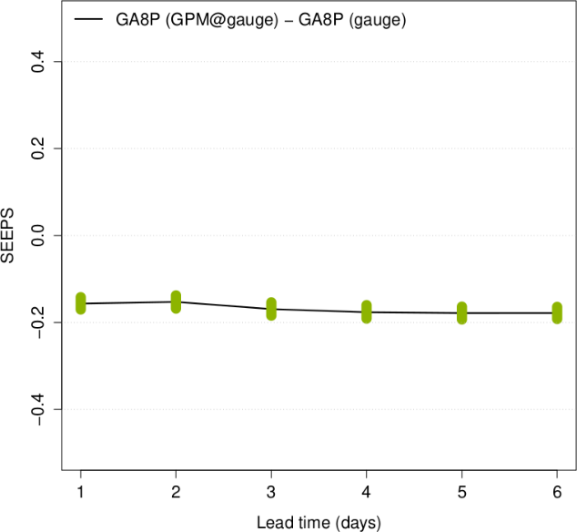
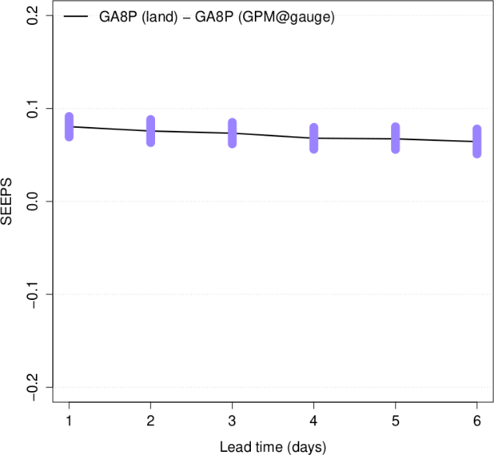
Practical question: What do you do when….
Model A is better than Model B
Model A is worse than Model B
Same forecasts; two different ob types; samples equalised
Two observation types give conflicting signals when comparing model A and B?
Different samples from the same observation give different results?
What do you conclude? What about relative magnitude of differences?
Model A against gauges is
better than Model A against GPM
GPM@gauge is subset of “land”
Model A at all land points is worse than Model A at only GPM land grid points containing gauges
Here the samples are equalised but two different ob types
Differences in SEEPS with bootstrap CIs shaded to show when A is better than B (green), A worse than B (purple), black not sig.

Slide 43
Questions?

Slide 44
Short score crib sheet

Slide 45
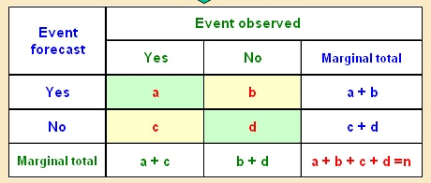
Basic measures/scores
Frequency Bias Index (Bias)
FBI > 1 over forecasting
FBI < 1 under forecasting
Range: 0 to
Perfect score = 1
Proportion Correct
simple and intuitive
yes and no forecasts are rewarded equally
can be maximised by forecasting the most likely event all the time
Range: 0 to 1
Perfect score = 1

Slide 46
Basic measures/scores
Hit Rate, Probability Of Detection, Prefigurance
sensitive to misses events and hits, only
can be improved by over forecasting
complement score Miss Rate MS=1-H=c/(a+c)
False Alarm Ratio
function of false alarms and hits only
can be improved by under forecasting
Range: 0 to 1
Perfect score = 1
Range: 0 to 1
Perfect score = 0

Slide 47
Basic measures/scores
Post agreement
Complement FAR -> PAG=1-FAR
not widely used
sensitive to false alarms and hits
Range: 0 to 1
Perfect score = 1
False Alarm Rate, Probability of False Detection
sensitive to false alarms and correct negative
can be improved by under forecasting
generally used with H (POD) to produce ROC score for probability forecasts (see later on in the week)
Range: 0 to 1
Perfect score = 0

Slide 48
Basic measures/scores
Threat Score, Critical Success Index
takes into account: hits, misses and false alarms
correct negative forecast not considered
sensitive to climatological frequency of event
Range: 0 to 1
Perfect score = 1
No skill level = 0
Equitable Threat Score, Gilbert Skill Score (GSS)
it is the TS which includes the hits due to the random forecast
Range: -1/3 to 1
Perfect score = 1
No skill level = 0

Slide 49
Basic measures/scores
Hanssen & Kuipper’s Skill Score, True Skill Statistic (TSS), Pierce’s Skill Score
popular combination of H and F
Measures the ability to separate yes (H)and no (F) cases
For rare events d is very large -> F small and KSS (TSS) close to POD (H)
Related to ROC (Relative Operating Characteristic)
Range: -1 to 1
Perfect score = 1
No skill level = 0
Heidke Skill Score
Measures fractional improvements over random chance
Usually used to score multi-category events
Range: - to 1
Perfect score = 1
No skill level = 0

Slide 50
Basic measures/scores
Odds Ratio
measures the forecast probability(odds) to score a hit (H) compared to giving a false alarm (F)
independent of biases
unbound
Odds Ratio Skill Score
produces typically very high absolute skill values (because of its definition)
Not widely used in meteorology
Range: 0 to
Perfect score =
No skill level = 1
Range: -1 to 1
Perfect score = 1

Slide 51
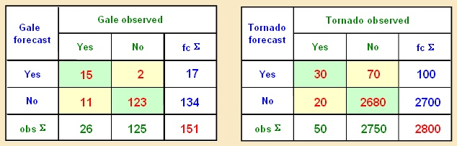
Practical problem:
Compute the scores for these
Two contingency tables and discuss.
Left panel: Contingency table for five months of categorical warnings against gale-force winds (wind speed > 14m/s)
Right panel: Tornado verification statistics
B = (a+b)/(a+c) ______ ______
PC = (a+d)/n ______ ______
POD = a/(a+c) ______ ______
FAR = b/(a+b) ______ ______
PAG = a/(a+b) ______ ______
F = b/(b+d) ______ ______
KSS = POD-F ______ ______
TS = a/(a+b+c) ______ ______
ETS = (a-a_{r})/(a+b+c-a_{r}) ______ ______
HSS = 2(ad-bc)/[(a+c)(c+d)+(a+b)(b+d)] ______ ______
OR = ad/bc ______ ______
ORSS = (OR-1)/(OR+1) ______ ______
GALE TORNADO

